Slide 1
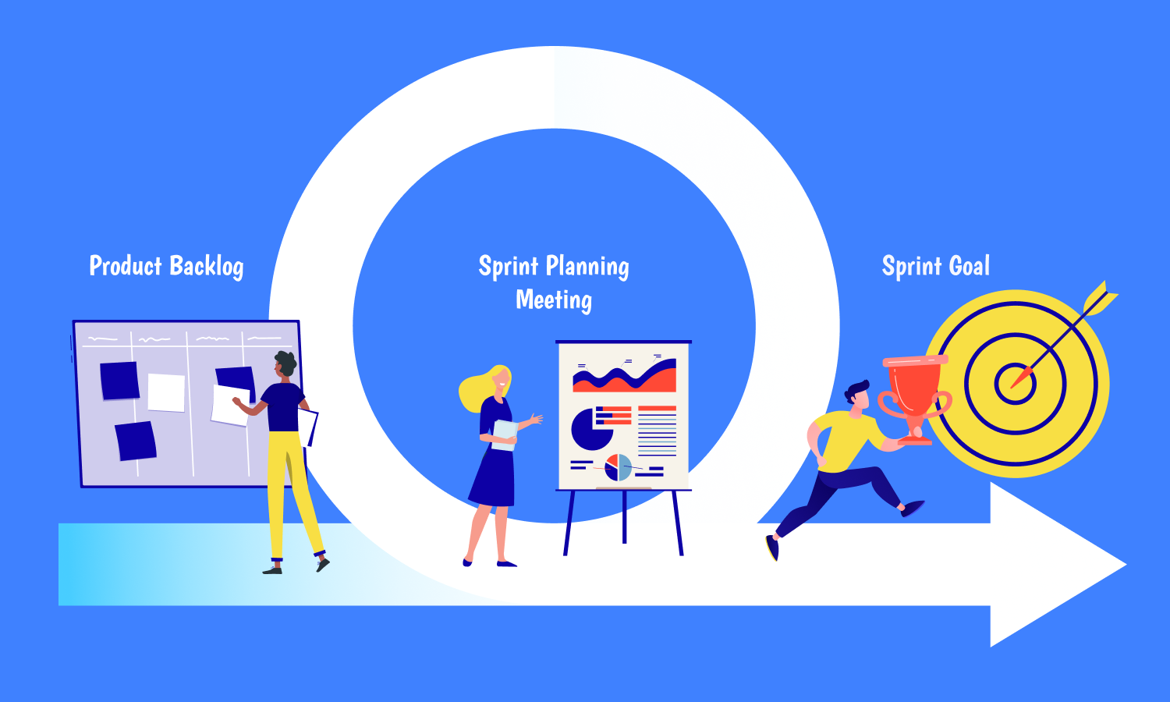
Software Design
Scrum Spring Planning and Tracking

Slide 2
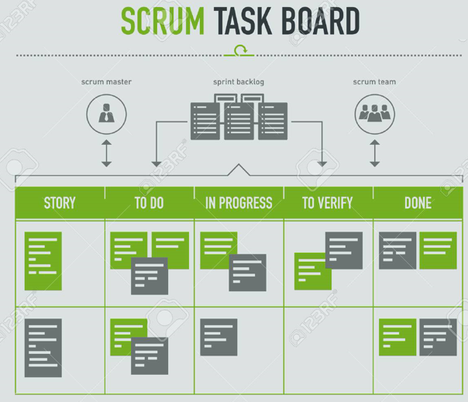
Scrum Task Board
Scrum board: a visual process tool to track work in sprints, e.g.
To Do: lists the tasks that are not yet started. (i.e., backlog)
Doing: the tasks that are in progress
Done: the tasks that are completed
https://www.youtube.com/watch?v=Ti2g66b7MUo
Source : www.123rf.com/
YL Hedley
2
Notes:
2

Slide 3
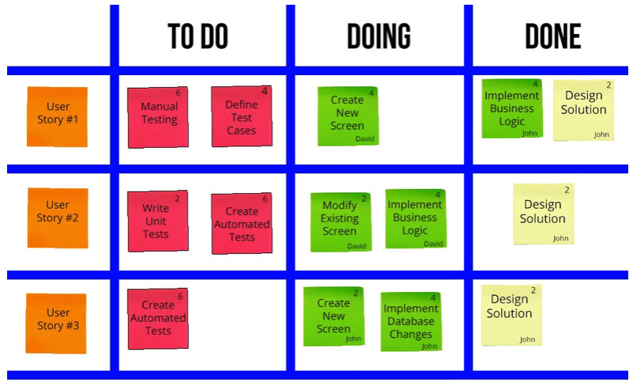
Scrum Task Board
YL Hedley
3
Notes:
3

Slide 4
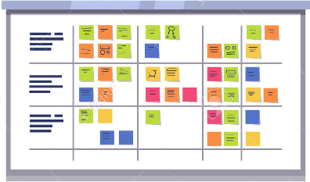
Scrum Tasks
Scrum Task Breakdown
To use the Definition of Done (DOD) as a checklist to produce a list of tasks
To use hours to estimate the amount of effort required to complete a task
Source : www.123rf.com/
YL Hedley
4
Notes:
4

Slide 5
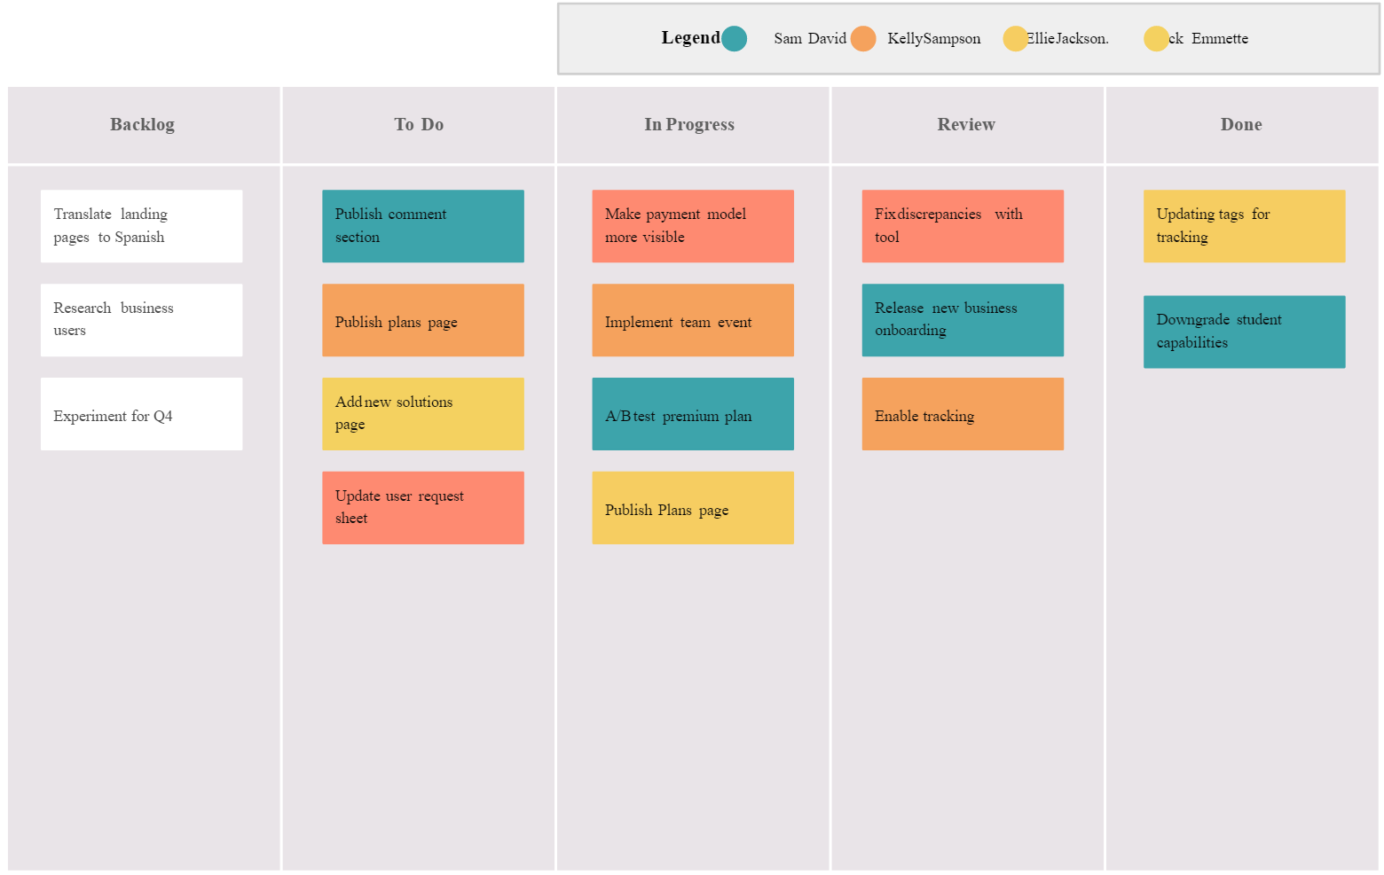
Scrum Tasks
YL Hedley
5
Notes:
5

Slide 6
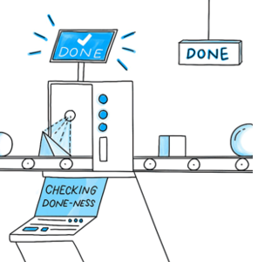
Definition of Done
DOD Example
User story: As a user, I want to be able to search a product, so that I can find the product I am looking for
DOD:
Design for product search is completed
Code for product search is completed
Tasks based on the DOD:
Produce the design model for product search function
Write code for the product search page
Source: https://medium.com/
YL Hedley
6
Notes:
6

Slide 7
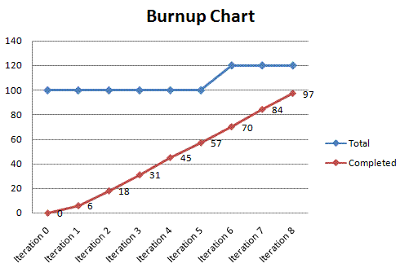
Sprint Planning & Tracking
Burn-up chart
shows how much work has been completed, and the total amount of work, which may be produced when the teams update their release plan
Source : Lcm-ua.org
https://www.youtube.com/watch?v=BVTZxAe-8Wc
YL Hedley
7
https://www.youtube.com/watch?v=o-DoeXeNjVE
Notes:
7

Slide 8
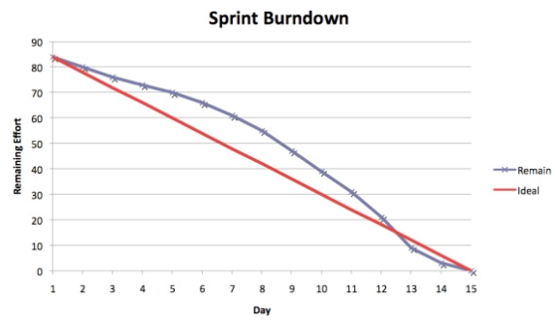
Sprint Planning & Tracking
Burn-down chart
shows how much work is remaining to be done in a sprint
Source developer.salesforce.com/
YL Hedley
8
Notes:
8

